Slide 1

7th Grade Math
Unit 7, Lesson 7 Solving Multi Step Problems Involving Discounts, Taxes, Tips, or Fees Volume 1, pg. 325

Slide 2


Benchmark
MA.7.AR.3.1
Apply previous understanding of percentages and ratios to solve multi-step, real-world percent problems.
volume 1, pg. 325

Slide 3
Integrated Mathematical Thinking and Reasoning Standards
MA.K12.MTR.3.1 Complete tasks with mathematical fluency.
MA.K12.MTR.6.1 Assess the reasonableness of solutions.
MA.K12.MTR.7.1 Apply mathematics to real-world contexts.
volume 1, pg. 325

Slide 4

Learning Target
I can solve multi-step problems that involve discounts, markups, taxes, tips, or fees.
volume 1, pg. 325

Slide 5

Warm-Up
volume 1, pg. 326

Slide 6
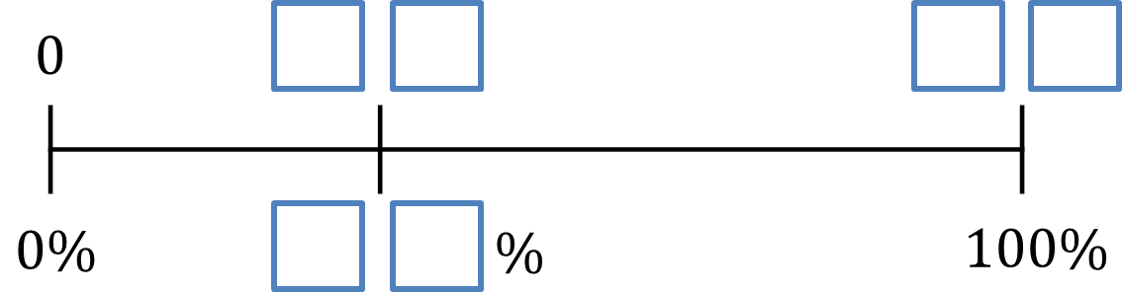
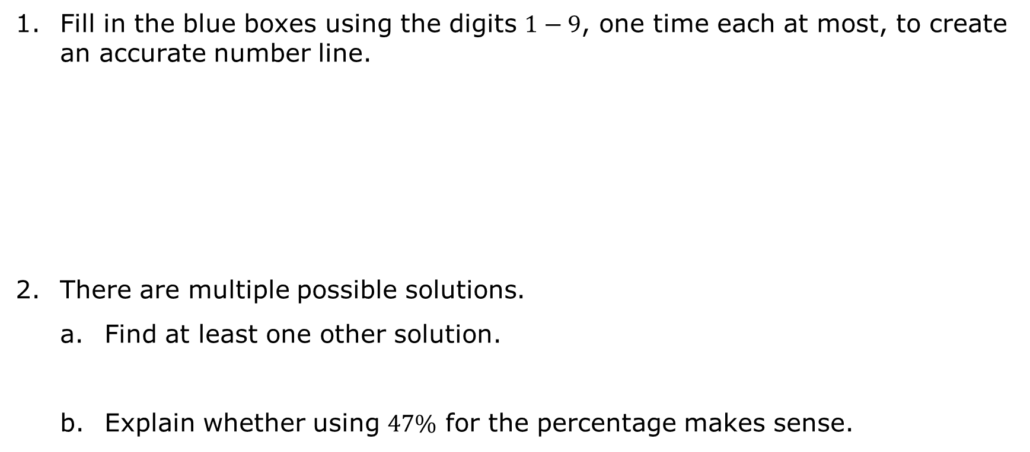
7.7.1 Warm-Up: Percentages on a Linear Model
Fill in the blue boxes using the digits $1−9$, one time each at most, to create an accurate number line.
There are multiple possible solutions.
Find at least one other solution.
Explain whether using $47\%$ for the percentage makes sense.
volume 1, pg. 326

Slide 7

Exploration
volume 1, pg. 326

Slide 8

7.7.2 Exploration: Finding Sales Tax Rates and Total Amounts
Cities often have different sales tax rates based on local government decisions.
Discuss with your partner how you might find the percentage of sales tax if you are given the price of an item and the amount of sales tax paid for the item. Summarize your discussion.
volume 1, pg. 326

Slide 9
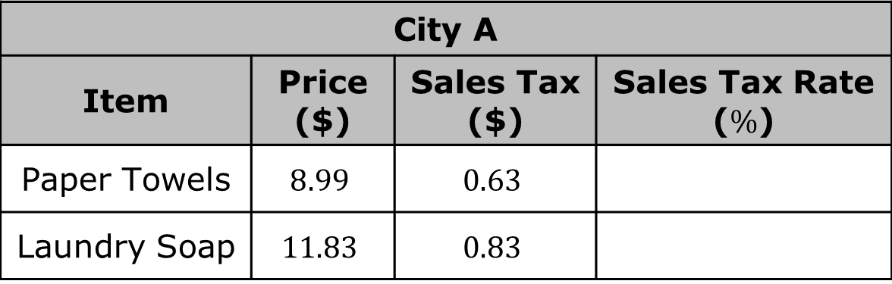
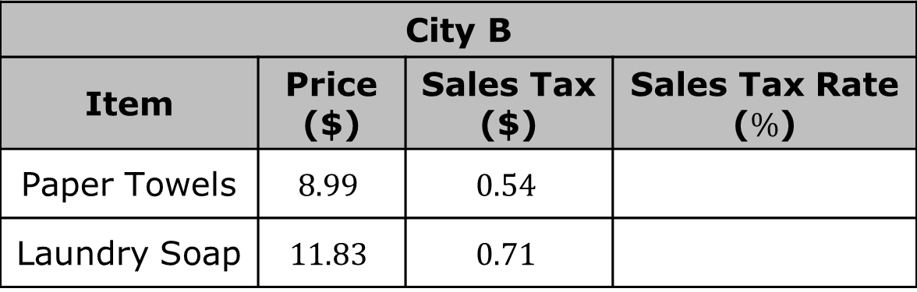
With your partner, complete the two tables to determine the sales tax rates for City A and City B.
City A
Item | Price ($) | Sales Tax ($) | Sales Tax Rate ($\%$)
Paper Towels | $$8.99$$ | $$0.63$$
Laundry Soap | $$11.83$$ | $$0.83$$
City B
Item | Price ($) | Sales Tax ($) | Sales Tax Rate ($\%$)
Paper Towels | $$8.99$$ | $$0.54$$
Laundry Soap | $$11.83$$ | $$0.71$$
volume 1, pg. 326

Slide 10
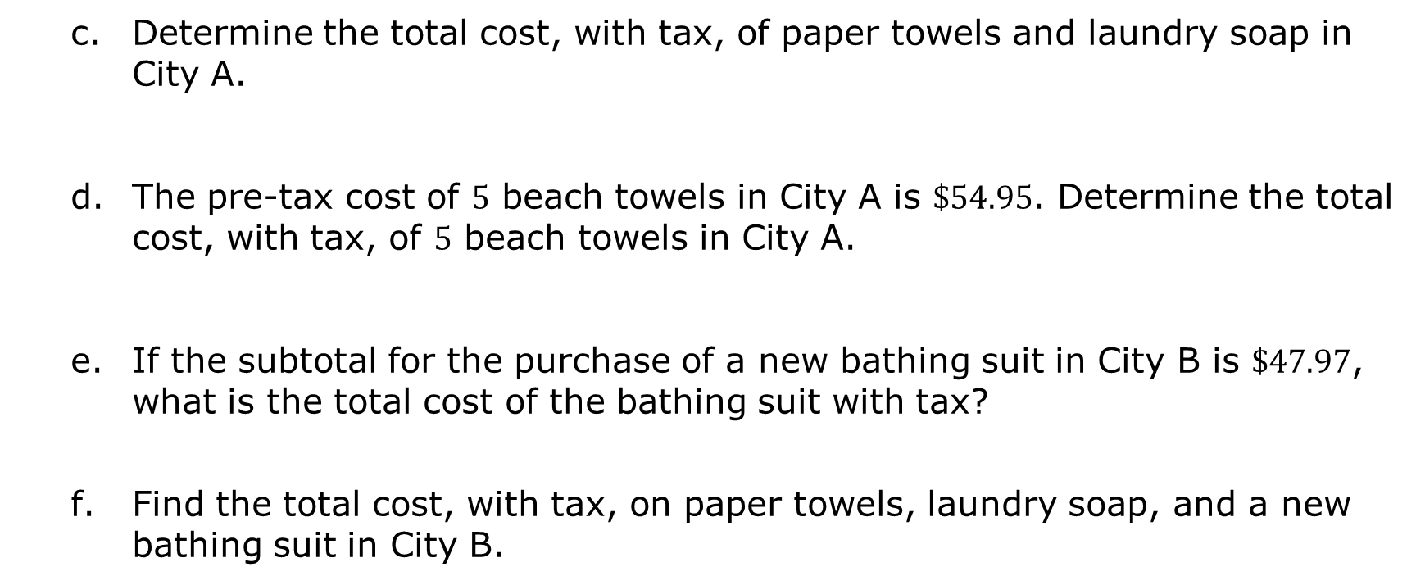
Determine the total cost, with tax, of paper towels and laundry soap in City A.
The pre-tax cost of $5$ beach towels in City A is $\$54.95$. Determine the total cost, with tax, of $5$ beach towels in City A.
If the subtotal for the purchase of a new bathing suit in City B is $\$47.97$, what is the total cost of the bathing suit with tax?
Find the total cost, with tax, on paper towels, laundry soap, and a new bathing suit in City B.
volume 1, pg. 327

Slide 11
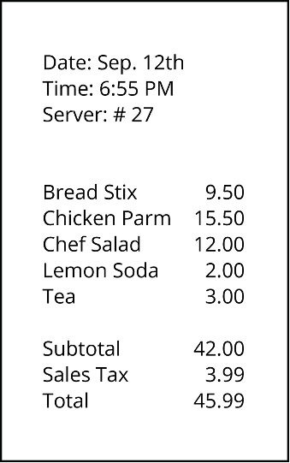
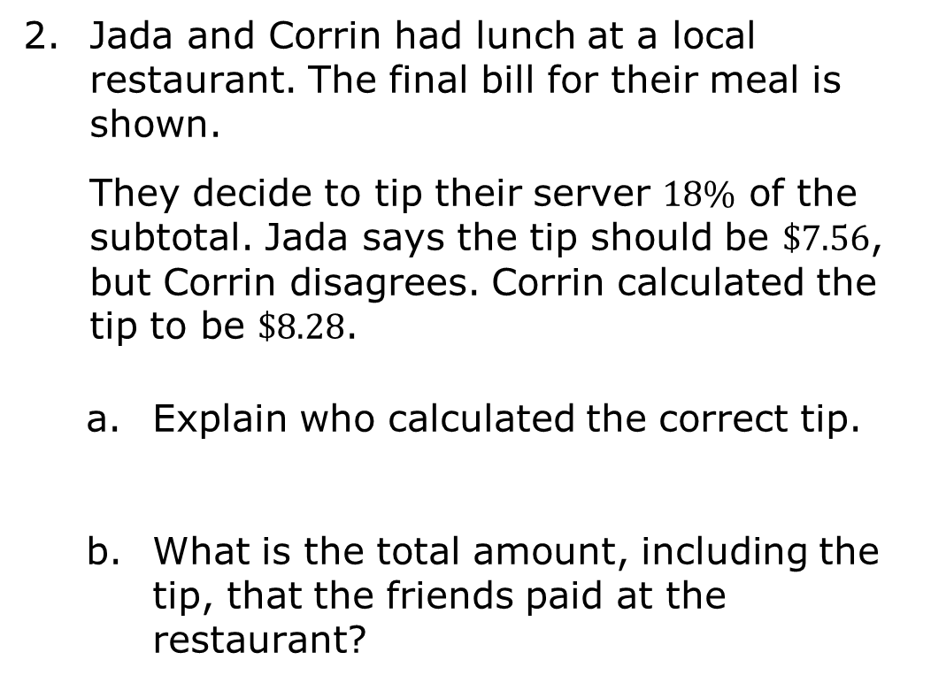
Jada and Corrin had lunch at a local restaurant. The final bill for their meal is shown.
They decide to tip their server $18\%$ of the subtotal. Jada says the tip should be $\$7.56$, but Corrin disagrees. Corrin calculated the tip to be $\$8.28$.
Explain who calculated the correct tip.
What is the total amount, including the tip, that the friends paid at the restaurant?
volume 1, pg. 327

Slide 12

Collaboration
volume 1, pg. 328

Slide 13

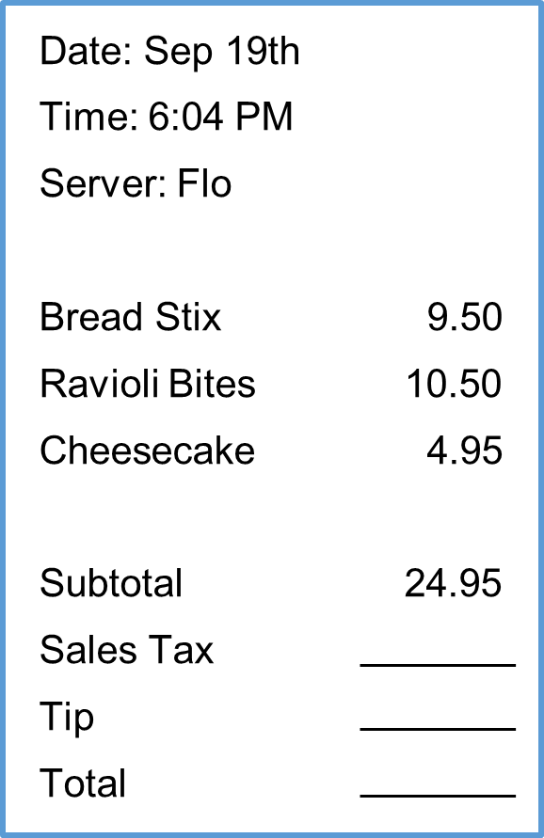
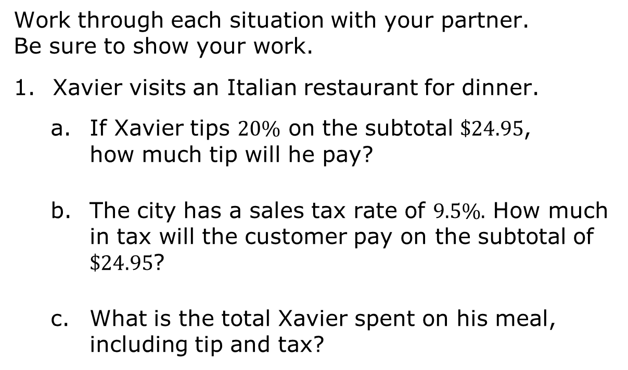
7.7.3 Collaboration: Taxes, Tips, and Totals
Work through each situation with your partner. Be sure to show your work.
Xavier visits an Italian restaurant for dinner.
If Xavier tips $20\%$ on the subtotal $\$24.95$, how much tip will he pay?
The city has a sales tax rate of $9.5\%.$ How much in tax will the customer pay on the subtotal of $\$24.95$?
What is the total Xavier spent on his meal, including tip and tax?
volume 1, pg. 328

Slide 14
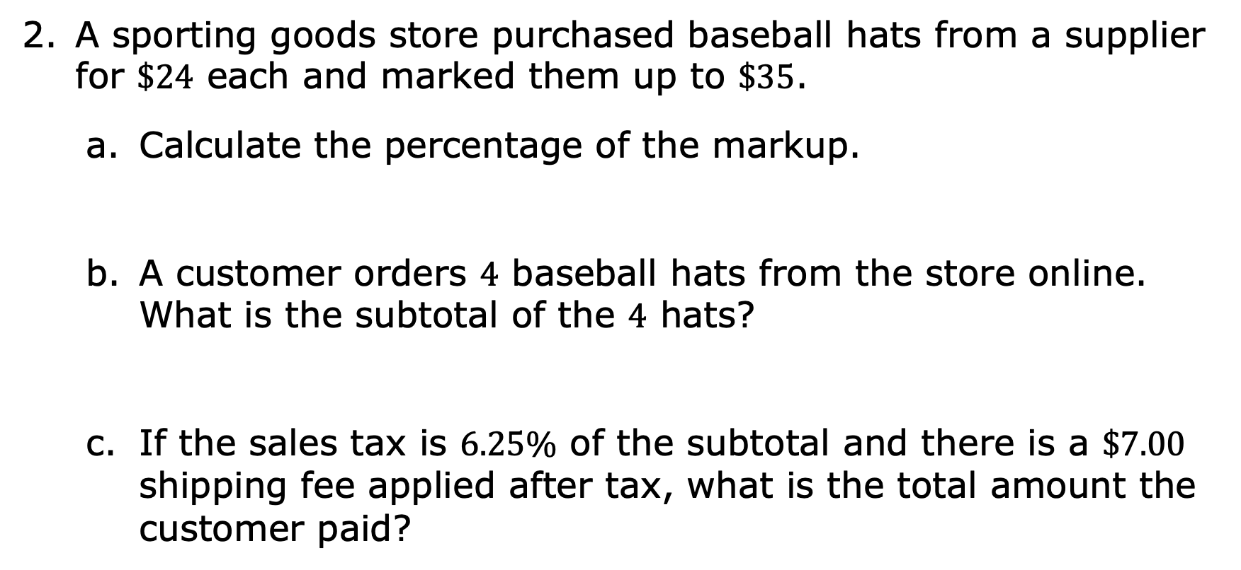
A sporting goods store purchased baseball hats from a supplier for $\$24$ each and marked them up to $\$35$.
Calculate the percentage of the markup.
A customer orders $4$ baseball hats from the store online. What is the subtotal of the $4$ hats?
If the sales tax is $6.25\%$ of the subtotal and there is a $\$7.00$ shipping fee applied after tax, what is the total amount the customer paid?
volume 1, pg. 328

Slide 15
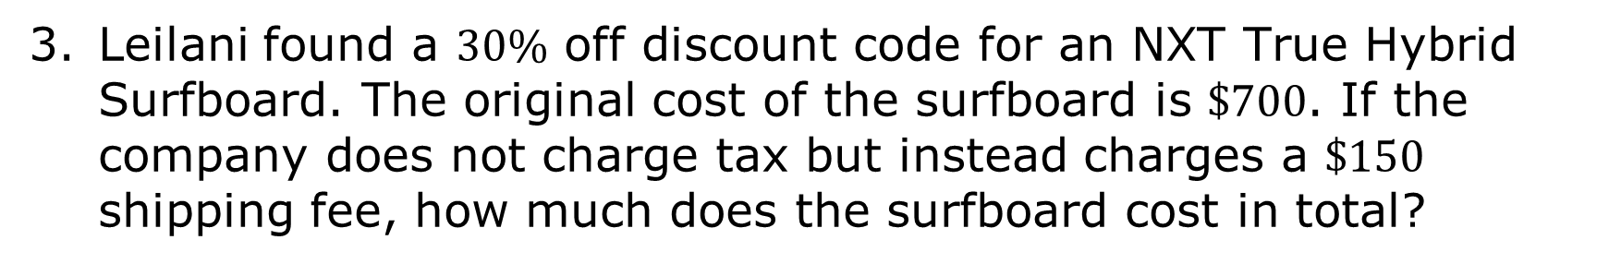
Leilani found a $30\%$ off discount code for an NXT True Hybrid Surfboard. The original cost of the surfboard is $\$700$. If the company does not charge tax but instead charges a $\$150$ shipping fee, how much does the surfboard cost in total?
volume 1, pg. 329

Slide 16

Your Turn
volume 1, pg. 329

Slide 17

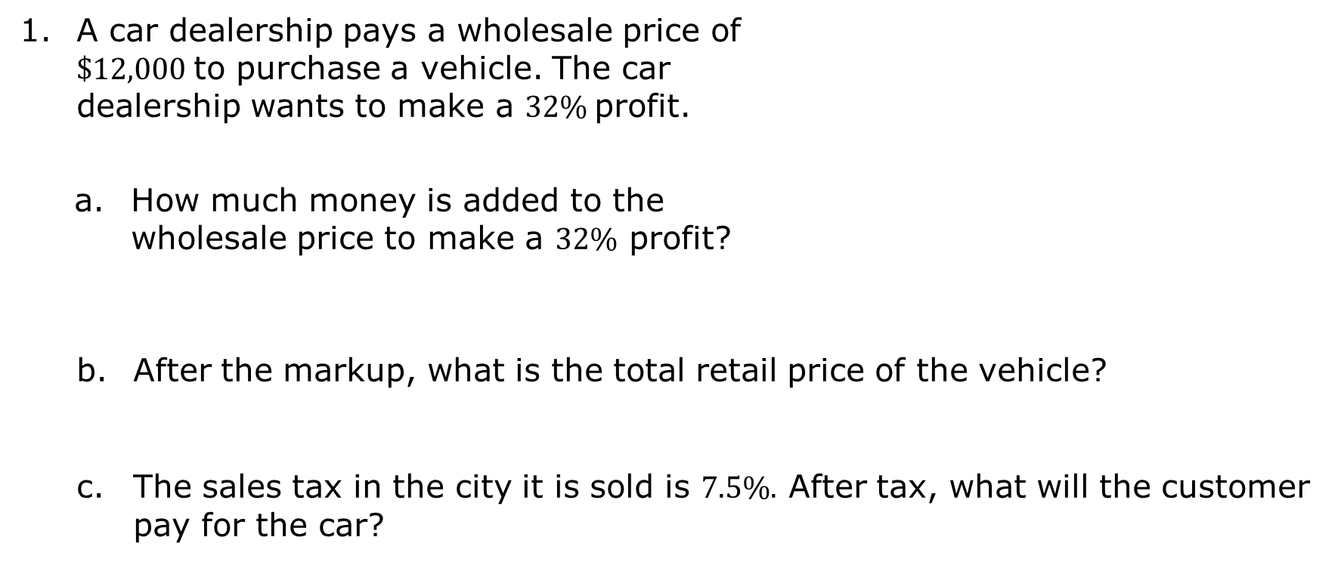
7.7.4 Your Turn!
A car dealership pays a wholesale price of $\$12,000$to purchase a vehicle. The car dealership wants to make a $32\%$profit.
How much money is added to the wholesale price to make a $32\%$ profit?
After the markup, what is the total retail price of the vehicle?
The sales tax in the city it is sold is $7.5\%.$ After tax, what will the customer pay for the car?
volume 1, pg. 329

Slide 18
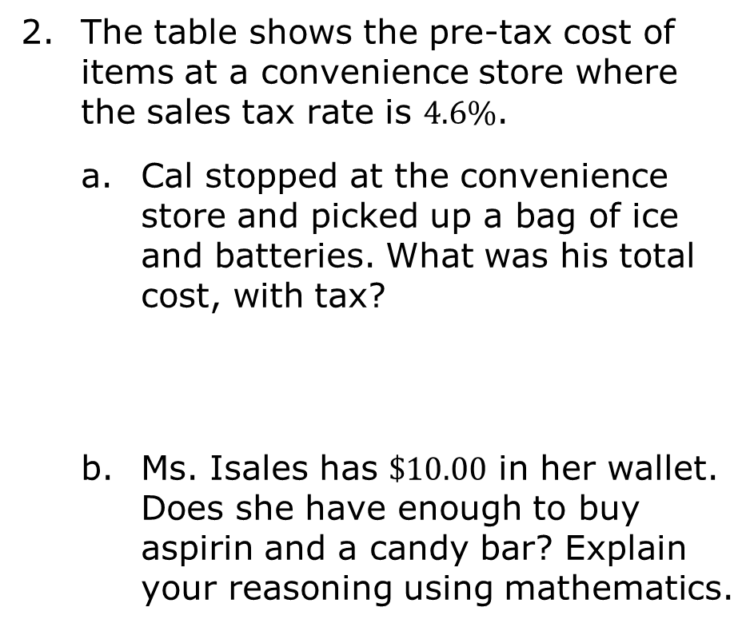
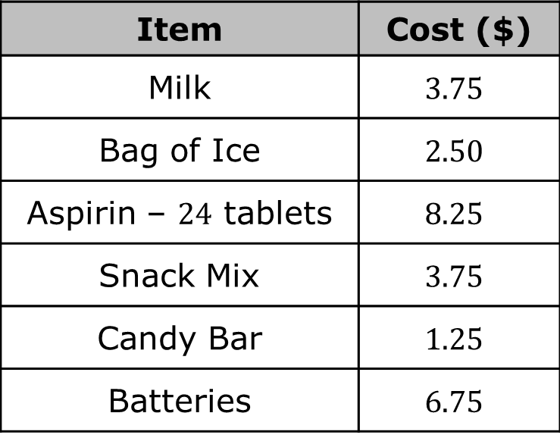
The table shows the pre-tax cost of items at a convenience store where the sales tax rate is $4.6\%$.
Cal stopped at the convenience store and picked up a bag of ice and batteries. What was his total cost, with tax?
Ms. Isales has $\$10.00$ in her wallet. Does she have enough to buy aspirin and a candy bar? Explain your reasoning using mathematics.
Item | Cost ($)
Milk | $$3.75$$
Bag of Ice | $$2.50$$
Aspirin – $24$ tablets | $$8.25$$
Snack Mix | $$3.75$$
Candy Bar | $$1.25$$
Batteries | $$6.75$$
volume 1, pg. 330

Slide 19
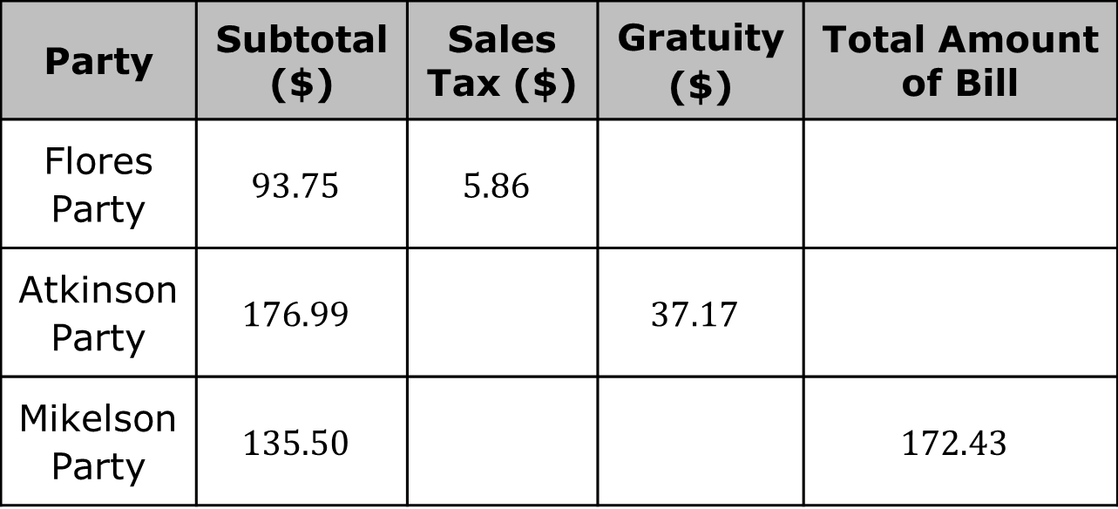
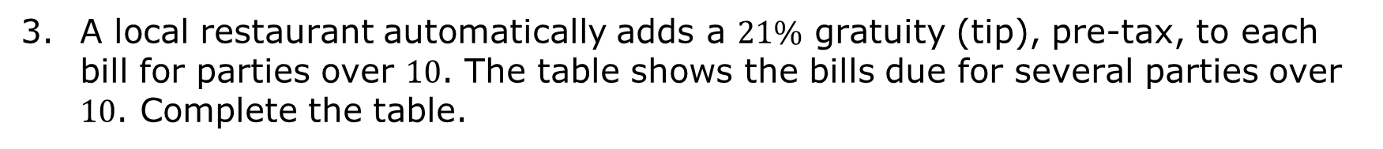
A local restaurant automatically adds a $21\%$ gratuity (tip), pre-tax, to each bill for parties over $10$. The table shows the bills due for several parties over $10$. Complete the table.
Party | Subtotal ($) | Sales Tax ($) | Gratuity ($) | Total Amount of Bill
Flores Party | $$93.75$$ | $$5.86$$
Atkinson Party | $$176.99$$ |  | $$37.17$$
Mikelson Party | $$135.50$$ |  |  | $$172.43$$
volume 1, pg. 330

Slide 20

Wrap-Up
volume 1, pg. 331

Slide 21
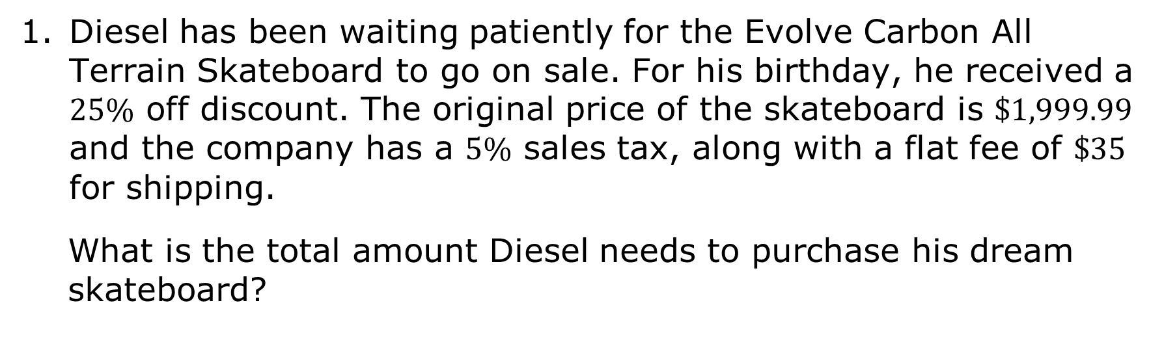
7.7.5 Wrap-Up: Ticket Out the Door
Diesel has been waiting patiently for the Evolve Carbon All Terrain Skateboard to go on sale. For his birthday, he received a $25\%$ off discount. The original price of the skateboard is $\$1,999.99$ and the company has a $5\%$ sales tax, along with a flat fee of $\$35$ for shipping.
What is the total amount Diesel needs to purchase his dream skateboard?
volume 1, pg. 331

